Slide 1

TRAFFIC JAM PROJECT
By Niels Blonk, Danny Bui, Laura Holtus, Marc de Jong, David Koymans, Daan de Munck, Ravan Strijker and Elio Verhoef

Slide 2
Our website

Slide 3
Why should you use our program?
Easy-to-use
Number-gathering
Adaptable
Customizable
True-To-Life

Slide 4
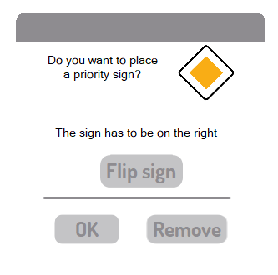
Why should you use our program?
Easy-to-use
Number-gathering
Adaptable
Customizable
True-To-Life

Slide 5

Why should you use our program?
Easy-to-use
Number-gathering
Adaptable
Customizable
True-To-Life

Slide 6
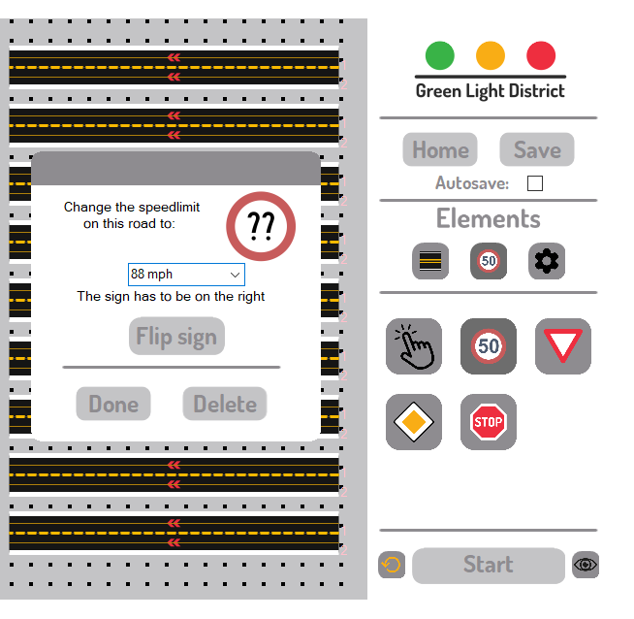
Why should you use our program?
Easy-to-use
Number-gathering
Adaptable
Customizable
True-To-Life

Slide 7
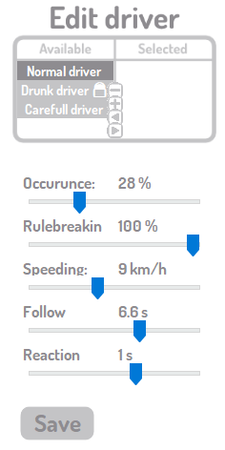
Why should you use our program?
Easy-to-use
Number-gathering
Adaptable
Customizable
True-To-Life

Slide 8
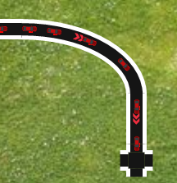
Why should you use our program?
Easy-to-use
Number-gathering
Adaptable
Customizable
True-To-Life

Slide 9
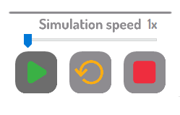
Time for a live demo!

Slide 10

The end of the line…
Time for questions!

